Slide 1
Sustainable Open Source Gardens
Paris Pittman
Kubernetes Open Source Strategy,
Google Open Source Programs Office

Slide 2
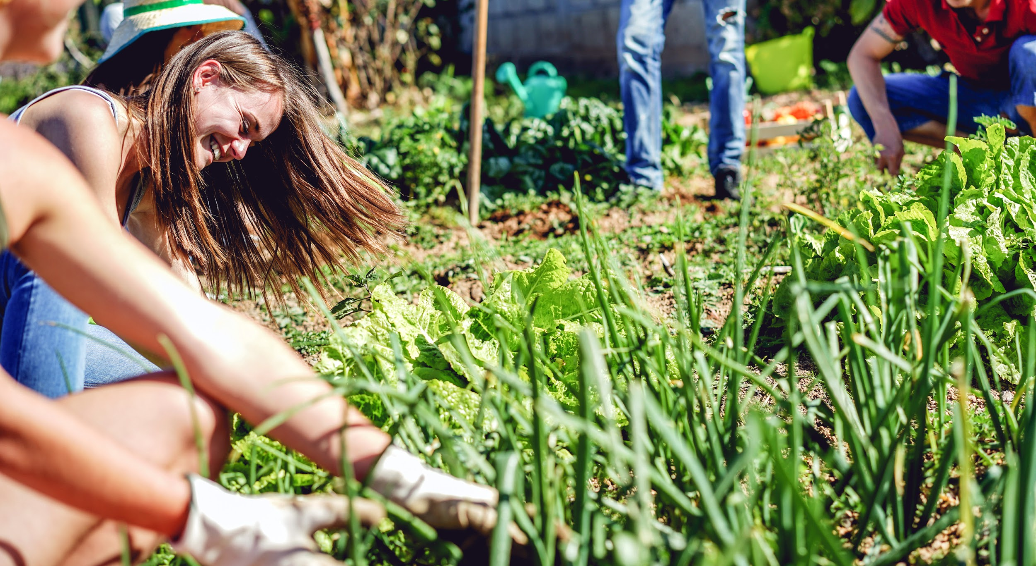
Notes:
We’ve heard free as in puppy or free as in beer as analogies for the freedoms of open source; when i was writing this talk I remembered the garden analogy that Steve Klabnik used to describe issue triage for Rails and Rust. The Go project has a wiki called "Gardening" dedicated to describing tasks to keep the project "healthy and nice-looking." So in true open source fashion - let’s extend the analogy. [next slide]

Slide 3
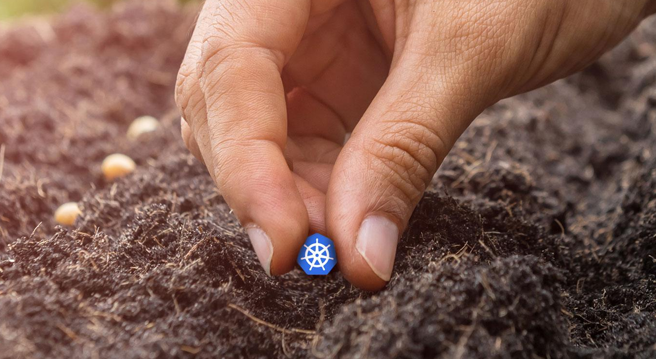
Notes:
Code is the seed we plant, [PAUSE]
we want it to grow, get adopters, production users...
And the project is everything around it that makes the seed grow
Open sourcing the code is the first step. When you plant a seed [PAUSE HERE] that doesn’t make the garden grow immediately, [OR HERE] there are a lot of things that need to happen between the seasons of growth. Mostly around [next slide]

Slide 4
sustain-
ability.
Notes:
...sustainability
Cool - your community (err garden) is up and running, now what?
Will your contributors and consumers be supported in the same way when things get boring? Are the right feedback loops in place? How are you growing new leaders? How will this project stay funded? How can we make it so there is never burden on just one person?
Thats a lot to think about when folks are working on enhancements, stability, and supporting a community as priority.
During the last 2 years at google, I’ve watched communities we care about like Kubernetes, Tensorflow, and nodejs build foundational programs to help weather through the changing seasons as not every one bears fruit. Not all projects have this type of support [PAUSE]
this is the interesting intersection[NEEDS NEW WORD] of value that companies provide [next slide]

Slide 5
intentional.
Notes:
By providing the action to back up the words. Being intentional. Many companies build their own product and community sustainability programs - and we learn from others across industries. Bringing that back into OSS is a key value add.
With sustainability you need to show up for it and not have it as an afterthought. bedrocks like values and principles will be the guiding light to the programs that you create. If you don’t live by them then why do you have them - it’s a part of the gardening plan. [next slide]

Slide 6
what do we consider gardening?
Notes:
What do we consider gardening?

Slide 7
make space for the seed to grow
Notes:
Well first, making sure the code grow up, out, and it can lay it’s roots err binaries.

Slide 8
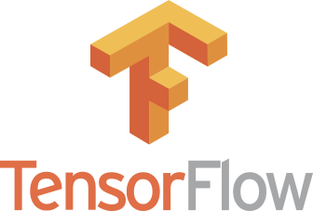
2,060
contributors
(merged prs)
downloaded approximately
3 million
times each month [*]
Notes:
An example, Tensorflow, a google created open source library for machine learning, implemented an RFC (request for comment) process to give users chances to be involved and insight into development process. The RFCs externalize design directions and open up to other use cases. combine that with the creation of special interest groups to break the work down and make it possible for community-driven development
and you’ve got your fertilizer!
But even if you have robust seed with plenty of fertilizer … you still don’t have a garden

Slide 9
taking care of your gardeners.
Notes:
plants don’t make the garden, the gardener makes the garden.
code doesn’t make the project, it’s not sufficient on it’s own to maintain a culture and support systems without contributors. They tell its stories, create its history, and share the fruits of their labor.
Not taking care of your gardeners is a risk to the projects future. Gardens can turn into jungles without gardeners [NEXT SLIDE]

Slide 10
#sig-contribex
CommComm
31,000
3000
Notes:
having intentional space for people to do sustainability is critical if you are looking to grow your project to new heights or stick around for a while. In kubernetes, we have a special interest group for contributor experience and nodejs has a similar group called CommComm (short for Community Communications)
Building trust is at the root of growing and retaining your contributor base. These groups work on contributor ladders that are well documented steps to achieving ownership. The ‘jump in’, ambigous contributing.md files, and “figure it out model” of the past is not sustainable. The same goes for 1:1 mentoring - building programs that are rational, scalable, and effective that met the needs of all of your contributors - not just new folks is critical. In Kubernetes, our programs cater to learning by doing, creating roles with shadows on teams like release, and creating space for mentors on demand like our monthly youtube series called meet our contributors that hundreds of contributors tune in to. We are empathetic to the fact that not everyone has the same background and learning styles and as Kay mentioned in her presentation - we want everyone to play.
We created 200 new kubernetes gardners just yesterday at the oscon workshop.

Slide 11
TEXT HERE
Notes:
So how do i contribute to the garden that is kubernetes, as a cochair of contributor experience i try hard to make it so people enjoy it here. Enjoy it enough that they ask other people to be in the garden and get dirty with them. Part of our work is providing the environment where the people can grow.
Part of the joy of gardening is the excitment of blooming. By making these things more enjoyable - we are making them more sustainable. If your project would like advice on bootstrapping something like this, swing by the google cloud booth or reach out to one of the groups I previously mentioned like contribex.
//To all of the companies looking for their place in the open source world, start here.
// somehow lead into this super rough pile of two options:
:
in kubernetes, im in the same owners file as people who contribute code in other parts of the project and the community repo is treated as first class, I'm an equal. That's an important part of the culture that we've built. Google and many other companies like Red Hat and VMWare invest in this(?)
Or
Folks always credit liking the community as a top reason they contribute (there is a recent carnegie mellon slide on this if i want to pull it up), so maybe the sustainability secret sauce is corporations funding contributor programs? (i have no idea where i was going with this); something something we know its important to have a group (sig-contribex, etc) in the community that focuses solely on these issues and that is one of the many ways google contributes to the health and sustainability to these open source projects.

Slide 12
thank you.
Paris Pittman
Kubernetes Open Source Strategy,
Google Open Source Programs Office
Notes:
Many people compare open source to a garden, - I like to think of it as a community garden. Some participate because it’s a hobby while some may rely on it it’s nutrients more than others. Steve Klabnik with the rust community has a similar analogy blog post that works well for tending issue triage gardens. I’ve heard my coworker Erin McKean say similar. So in true open source fashion - let’s extend the analogy. [next slide]

